Slide 1

Understanding TikTok's Recommendation Algorithm
Article by Ren Zhou
Tsinghua University, Beijing, China
Presented by Cosmin Tianu and Razvan - Andrei Bobos

Slide 2


Introduction
Overview of TikTok
Purpose of the article

Slide 3



ALGORITHMIC TRANSPARENCY ISSUES

Slide 4



TikTok’s Recommendation Algorithm
Collaborative filtering
Content-based techniques

Slide 5



ANSWER THE QUESTION
METHODOGLOGY

Slide 6




Data collection
Dataset
Metrics
Collection methods
Data Integrity
Large dataset of TikTok user interactions
Likes, shares, comments, view counts
TikTok’s public API and web scraping tools.
Methods employed to ensure compliance and data integrity

Slide 7
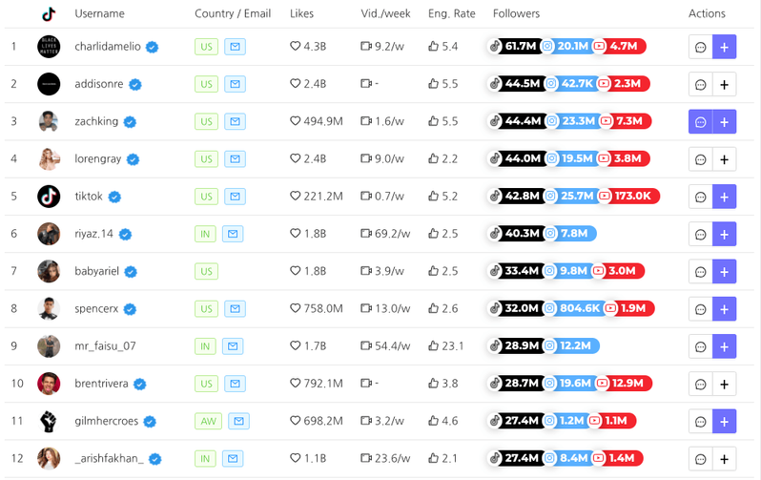
01
User features
02
Content features
Feature engineering
03
Interaction Features
04

Slide 8
Statistical Analysis
Correlation Analysis
Identified significant relationships between variables
Regression Analysis
Quantified the impact of each feature on recommendations
Regression Model Used
Ri​=β0​+β1​F1​+β2​F2​+…+βn​Fn​+ϵi​

Slide 9



Machine Learning Models for Prediction
Training & Validation
Performance Metrics
Models Used
Logistic Regression
Decision Trees
Gradient Boosting Machines
Utilized cross-validation techniques for robustness and generalizability
GDB:
Accuracy: 82%
Precision: 78%

Slide 10

Algorithm
Transparency
FOR USERS
01

Slide 11


THANK YOU
END

